Slide 1
Introduction to Software Business Product management
Week 1 Day 2
Led by: Emily Crose
for
Oakland University

Slide 2

Day 1 recap

Slide 3

Question or clarifications?

Slide 4
What is programming?
Notes:
Programming is our ability to give a computer a set of tasks that it can execute.

Slide 5

Manual vs. automation
Notes:
How do we decide when we need to automate something?

Slide 6
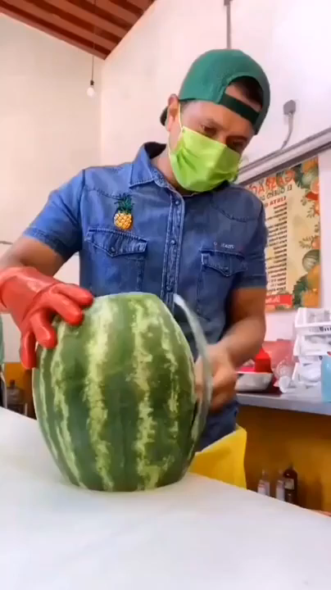
Notes:
In the world of computers, you can choose to do any given task one of two ways mainly. You can do things manually, and that might work just fine if all you need to do is a single task a single time. But at scale, it doesn’t matter how good you are at executing that task. At a certain point, automation will always make more sense.

Slide 7
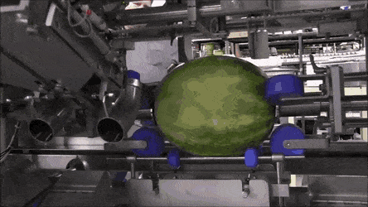

Slide 8

Process flowchart
Notes:
We can also use flowcharts as a tool to outline the way that information is generated and processed by a system. Using tools like pseudocode and flowcharts can help build an idea of exactly how the program will do what it’s supposed to do.

Slide 9

“Pseudo”code
Notes:
The exercise of producing “pseudocode” can help solidify concepts into achievable actions which can be programmed and build as an application.

Slide 10
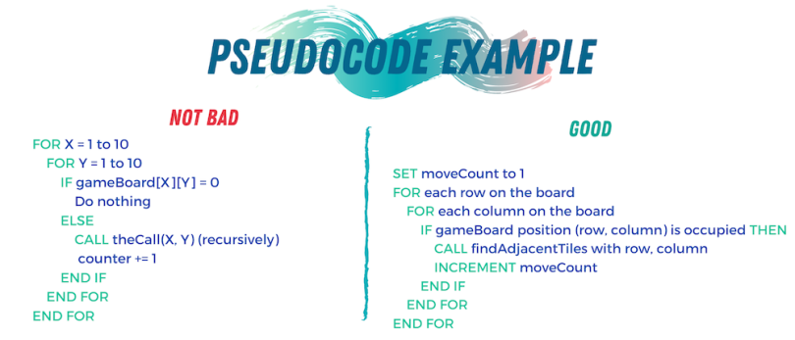
Pseudocode example

Slide 11
Loops

Slide 12
If/Then loops

Slide 13
For loops

Slide 14
While loops

Slide 15
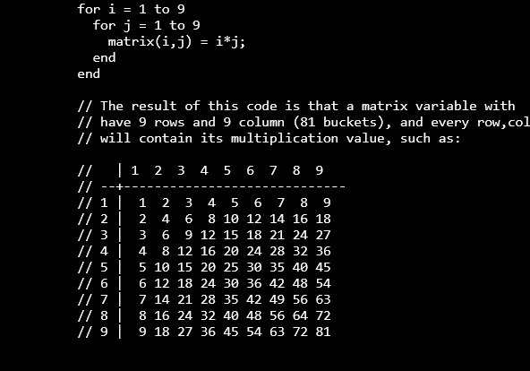
Nested Loops

Slide 16
Case statements

Slide 17
How Does an App get made?

Slide 18

Modern software development concepts
Notes:
Today, we’re going to talk at a high level about how modern software is imagined, developed and delivered. We will get into more specifics on this process when we examine the Software Development Life Cycle, but for now, let’s try to visualize exactly how software construction works.

Slide 19

Why would we make an app?
Notes:
You may be wondering why we would want to use software at all to solve any of our problems. The modern world has turned to software largely because of how versatile it is at solving modern problems. It’s not just about entertainment, it’s about letting technology reduce human toil.

Slide 20
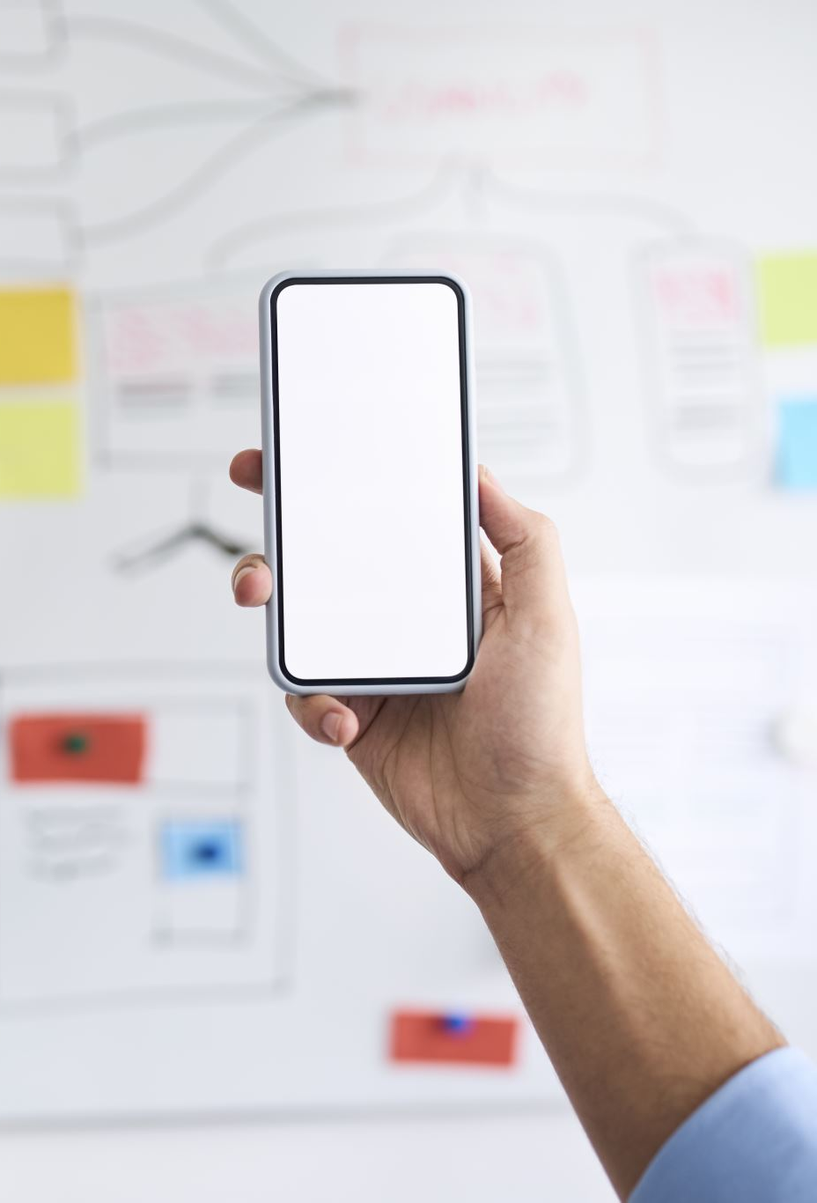
How do we build a quality app?

Slide 21

What is the problem?
What problems does this app solve?
How does it solve these problems?

Slide 22

syntheszing a solution
Notes:
We will need to synthesize the solutions we’ve come up with into an app.

Slide 23
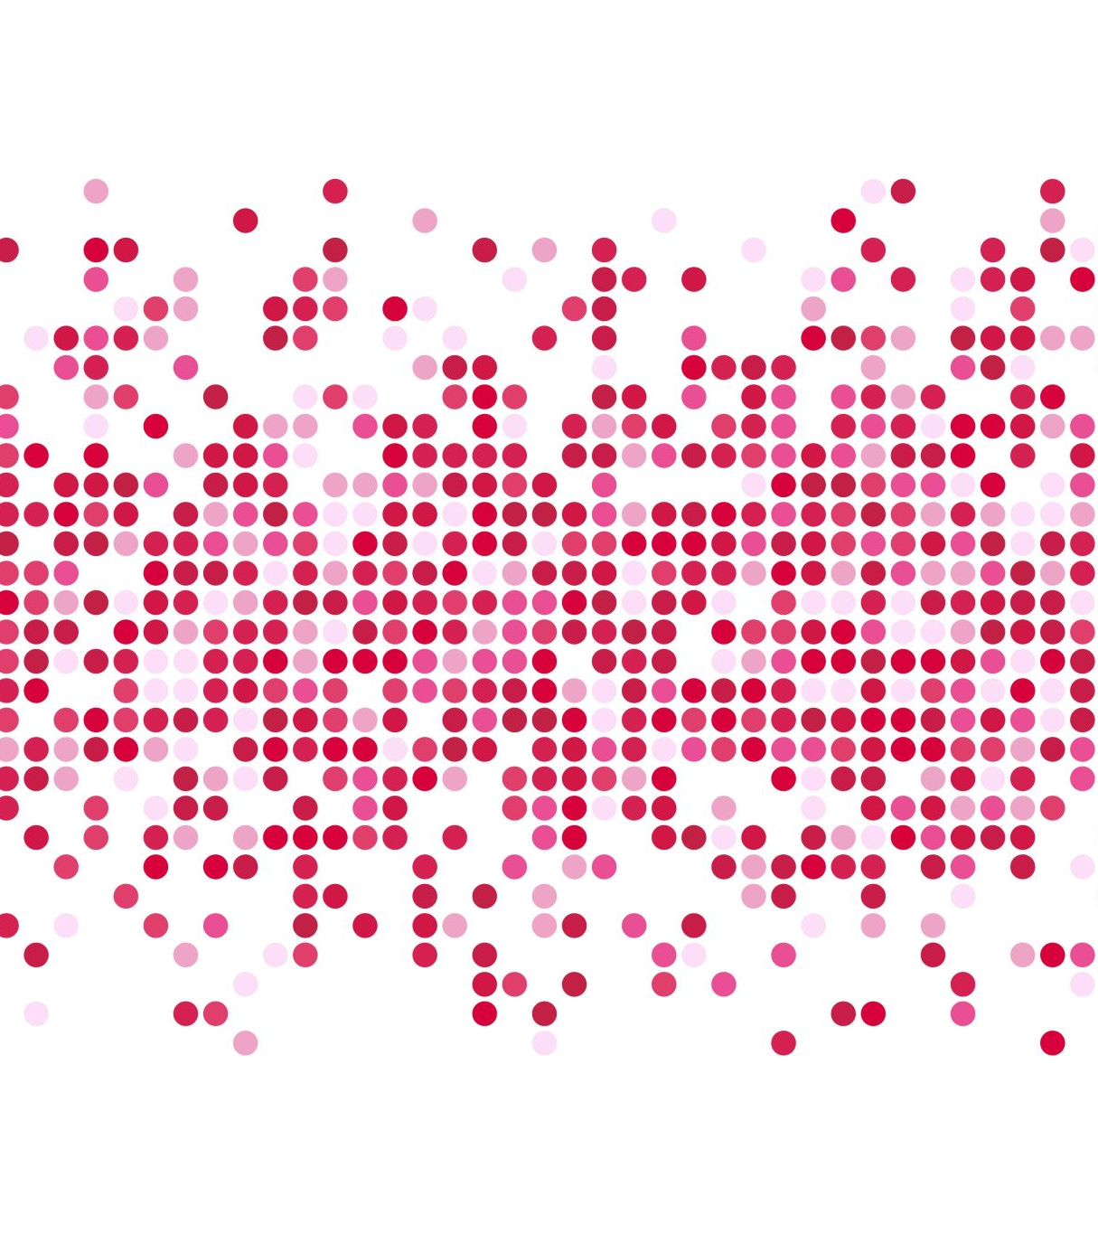
Generating requirements

Slide 24

Who makes software?
Notes:
To make modern software, it takes teams of people. It used to be the case that one rockstar developer could build and market an entire app all on their own. Applications today typically take a lot more people to make a successful application.

Slide 25
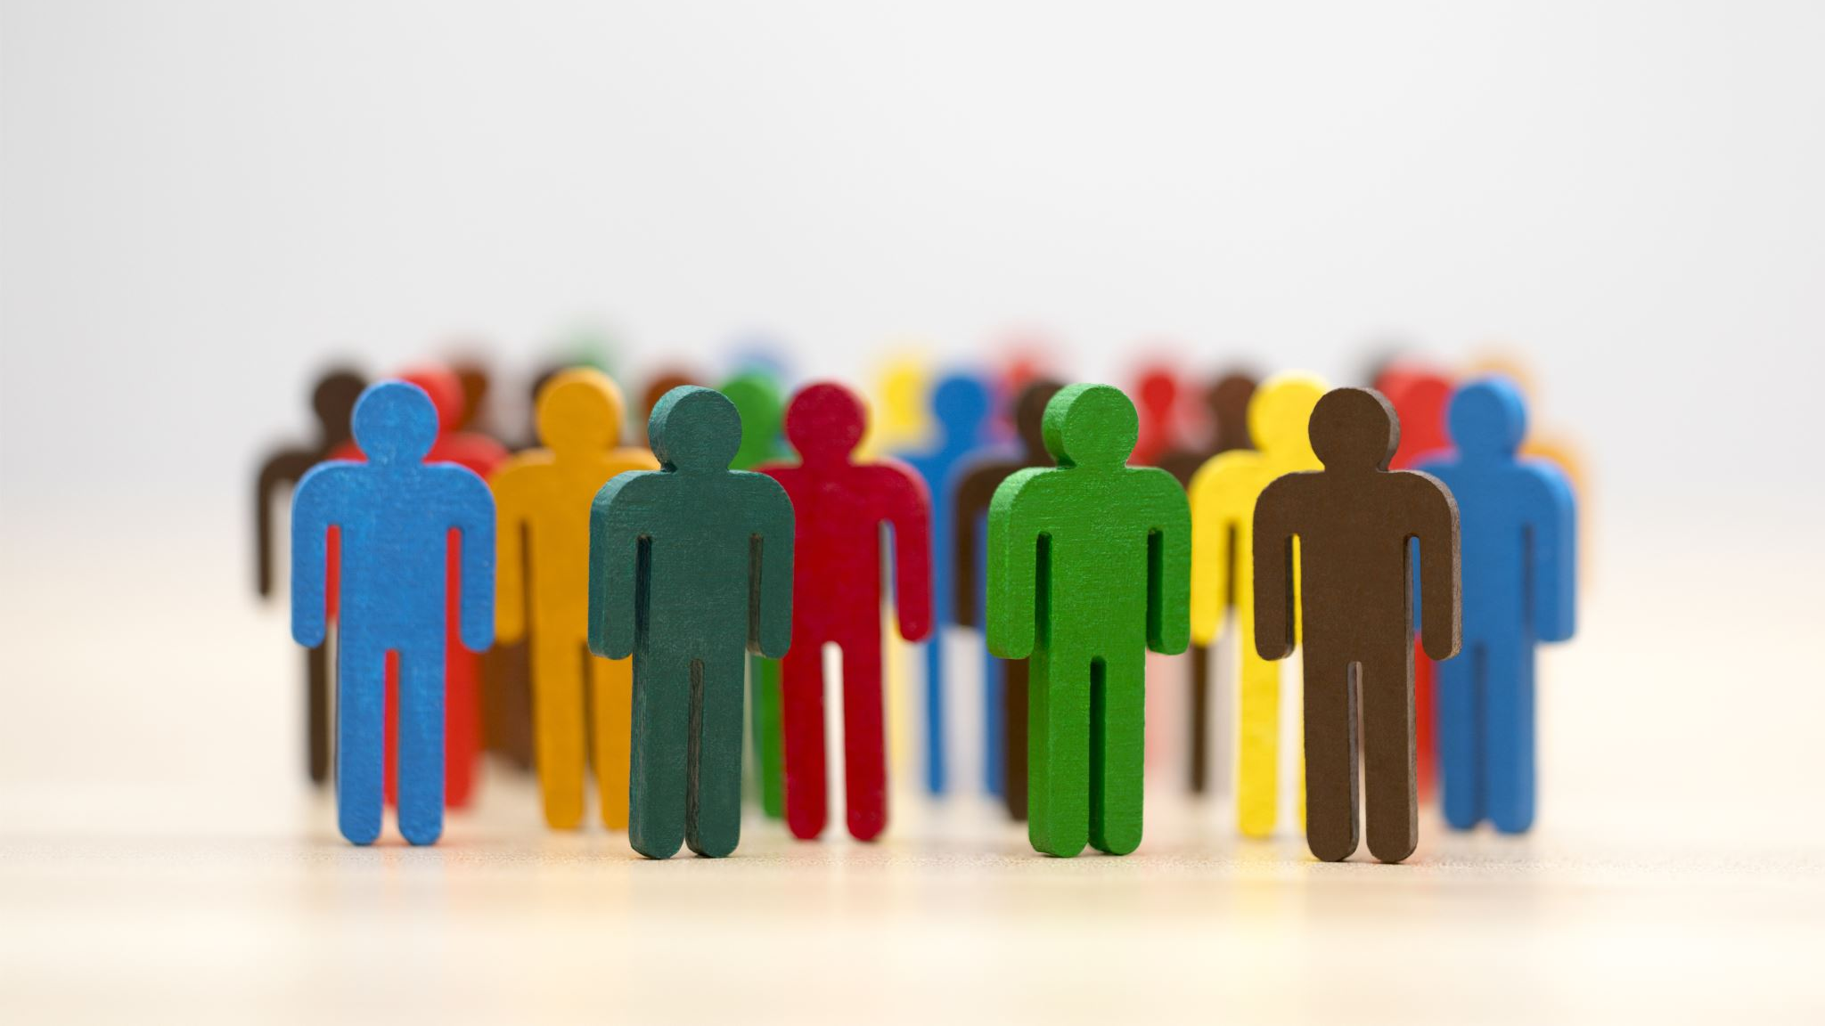
Leaders & managers
Notes:
Like any other project, there are leaders and managers involved in the process of creating an application. Generally speaking, project leadership make high level design decisions about how an application should function. This of course is only a small part of the puzzle.

Slide 26

Developers
Notes:
Developers are the lifeblood of executing program design. So when a design choice is made, how that choice gets implemented into the application is passed onto the developers. The “devs” then find the best way of putting the new feature into the program.

Slide 27

Separation of duties
Notes:
Separation of duties are important for defining exactly how and where processing happens. We will talk more about this topic when we get deeper into technical explanations, but for now, we should be aware that the specifics of how we process information is important.

Slide 28
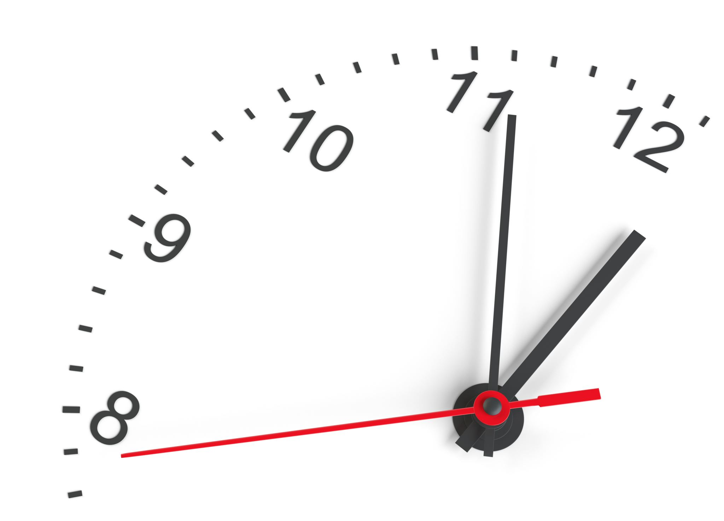
10 minute break

Slide 29

Testing
Does the code work as expected?
Does the code solve the problem we identified?
What does the code work on?
Does the code function with all of our supported systems?
Do we even know what possible systems exist in the field?
Notes:
When we do our testing, we need to ask a few questions about the app’s functionality.

Slide 30
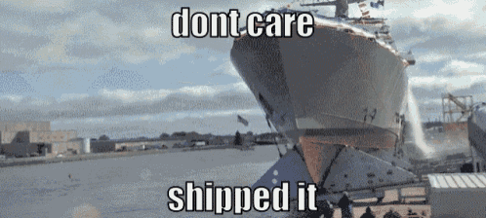
Code distribution

Slide 31
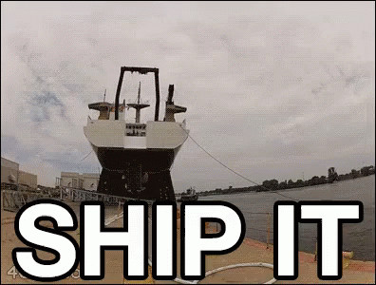
Problem discovery
Notes:
What happens if we discover a problem after we ship the code? What are our options?

Slide 32
Who are our users?
Do we know who they are?
What kind of sensitive information might we be processing?
Personally identifiable information?
HIPAA information?
Legally sensitive?
Notes:
Who are our users? What do they care about? Is there any sensitive information we may be processing that we need to take into account?
Is there a chance that we will run into unforeseen legal governance that will complicate either the way that we process information or store that information.

Slide 33
Supporting those customers
How do our customers contact us?
How do we contact them?
Do we have field support?
What is our process for addressing customer concerns/complains?
What is our process for addressing customer feature requests?
Ticketing system?

Slide 34
Application Programming Interfaces (APIs)
What do they do for applications?
When would we want to use an API?

Slide 35
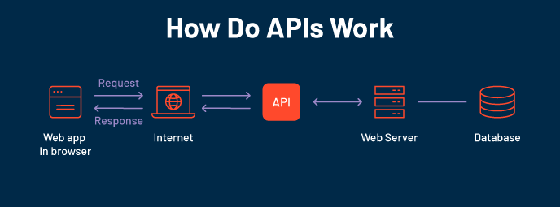

Slide 36
Familiar APIs
Representational State Transfer (REST or RESTful) API
Fast
Reliable
Widely adopted
Simple!
Simple Object Access Protocol (SOAP)
Used in some OT network appliances
Browser API
iOS/Android API
Allows developers the tools they need to utilize local resources in their own programs
Notification API calls
Camera activation
Media integration

Slide 37
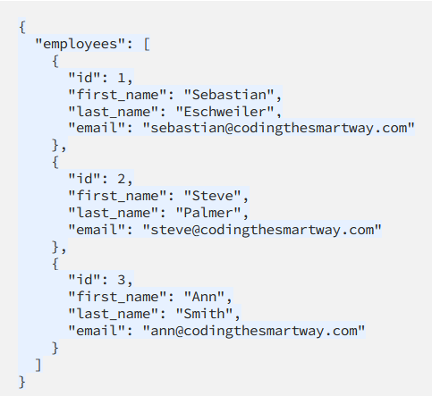
Notes:
Let’s take a look at a JSON form providing us information through an API interface. So when we use an API to retrieve information, we will typically be grabbing that information from a formatted file like a JSON file. We can see from this JSON file that actually this looks kind of like a database file.

Slide 38
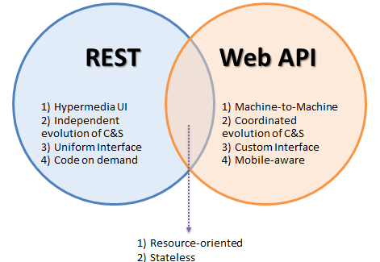
Popular API Frameworks

Slide 39
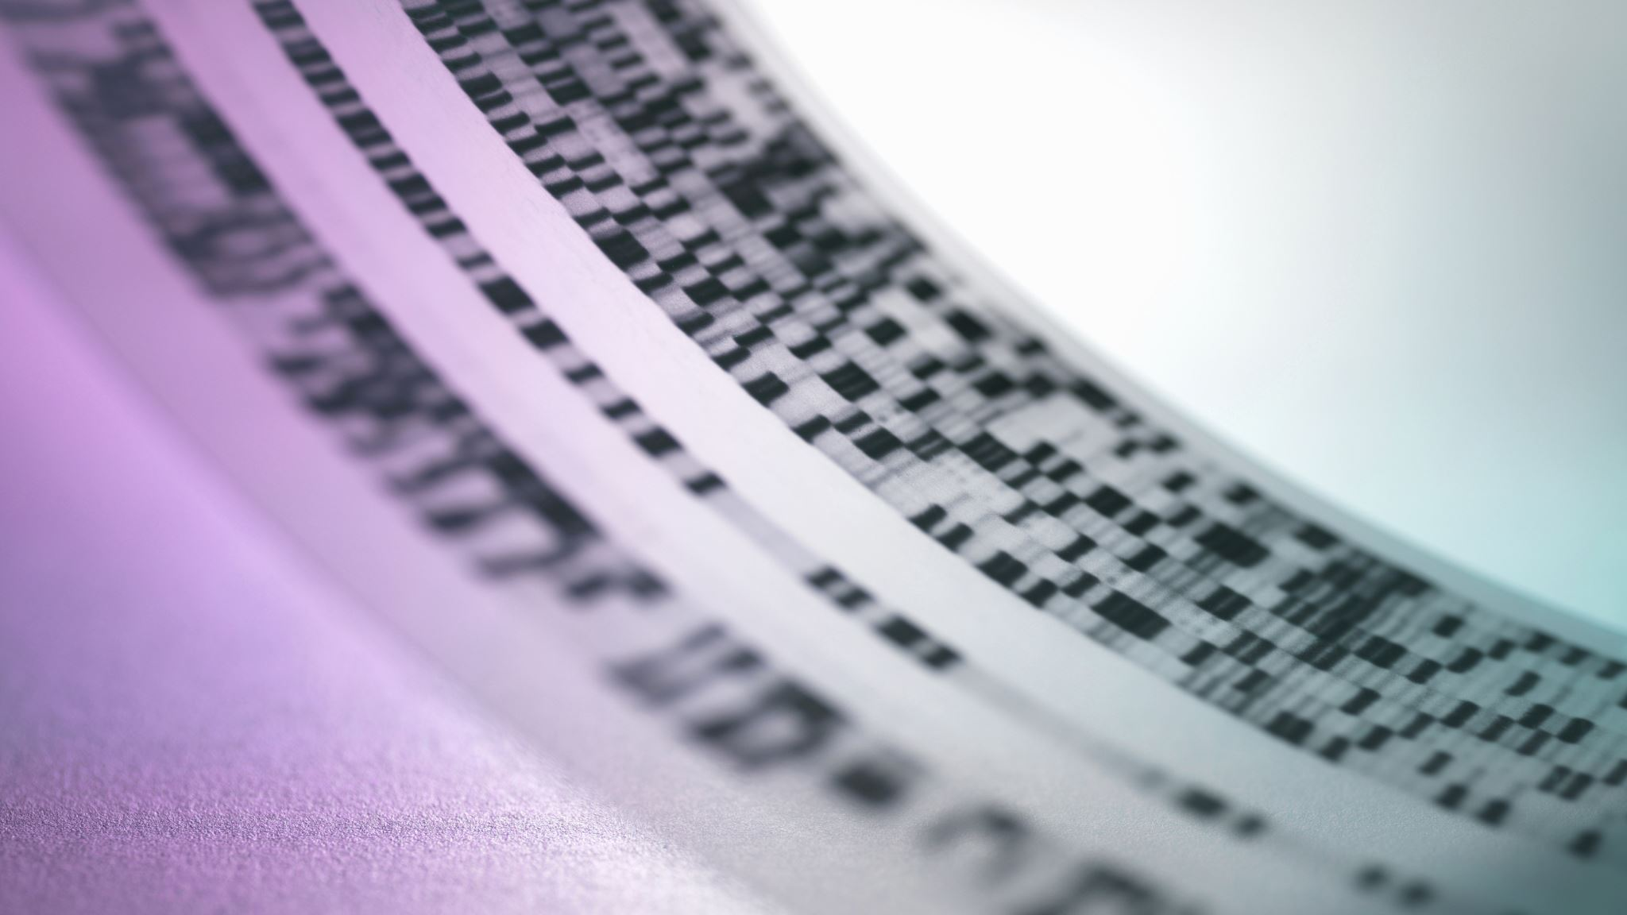
HTTP/Web API

Slide 40
HTTP API Verbs
HTTP
GET
POST
PUT
DELETE

Slide 41
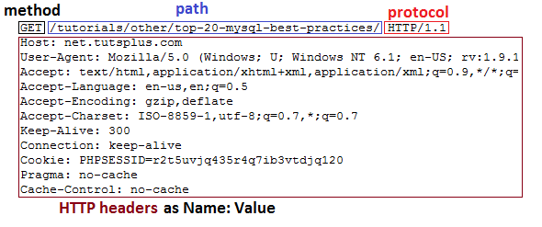
HTTP GET Header

Slide 42
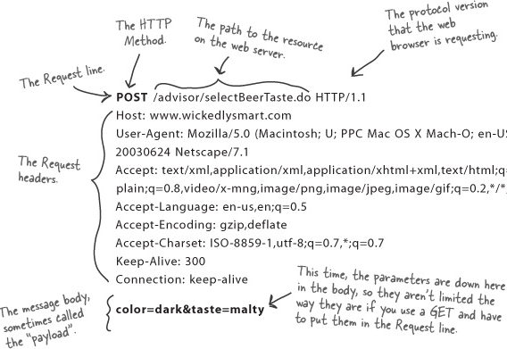
HTTP POST Header

Slide 43
Weather API Documentation
https://rapidapi.com/weatherapi/api/weatherapi-com
Notes:
A word on documentation – we should always start with the documentation when we go to program with an API

Slide 44
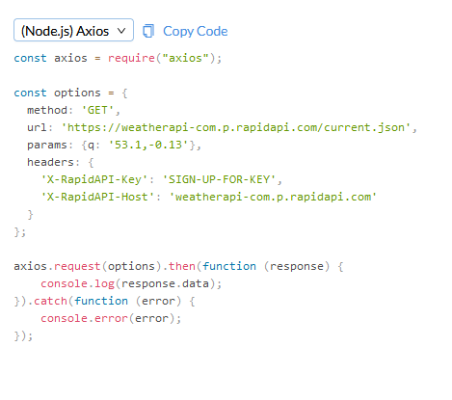
Notes:
So let’s take a look at what an API actually looks like in practice.

Slide 45
Working With APIs
Can be programmed
Can be used in a raw request

Slide 46
Programming Mobile Apps w/APIs
Android
Kotlin
Apple iOS
SWIFT
Both have access to device APIs!

Slide 47
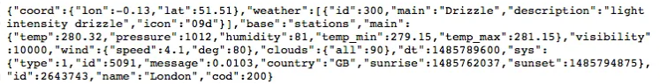
Mobile Device API Example

Slide 48
10 minute break

Slide 49

Securing APIs

Slide 50
SAML vs. Oauth
Security Assertion Markup Language (SAML)
Windows uses this for Single Sign On (SSO)
Integrates with Windows domain
Optimized for enterprise security
Oauth
Optimized for mobile applications
Uses API calls itself!
Tends to play better with mobile & lightweight IoT environments

Slide 51

What is Oauth?

Slide 52
Oauth
Allows one application to validate itself with another application
Uses tokens for authentication
We give applications permission to play with other applications via Oauth
Think of it like a valet for your apps!

Slide 53
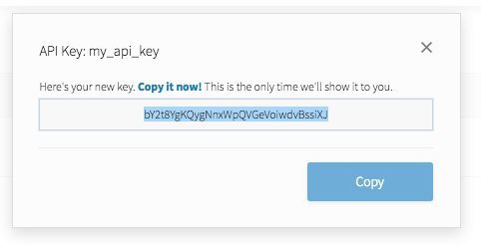
API Key
Notes:
API keys are meant to be kept secret. Why? Because they include information related to one specific account.

Slide 54

Why Do We Need API Keys?
Account verification
Who is requesting what information?
Rate limiting
Avoid denial of service
Permissions
What do we want to allow certain people to see?

Slide 55
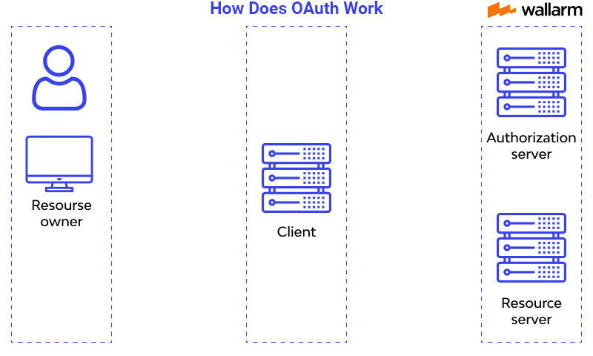
How does OAuth work?

Slide 56
Let’s Make A Github Account!
https://github.com

Slide 57

Software Development: The Lifecycle

Slide 58
What is the Software Development Life Cycle?
The SDLC helps us organize the process of building software
Includes steps for building, revising, and deploying software
Includes roles associated with each step along the building process

Slide 59
Why Do We Need An SDLC?
Notes:
We’ve spent two full weeks talking about how software functions, how software can go wrong, and some about how we build software. So by now, it should be obvious that software development is a fairly complicated subject. What we need is a notional concept to fit all of the components of software development into if for no other reason than organization.
For each of the functions of the process of building software, we will have multiple groups with multiple people all working together to create functional applications. This means we have a lot of moving human parts which can be challenging to successfully navigate without a common understanding.

Slide 60
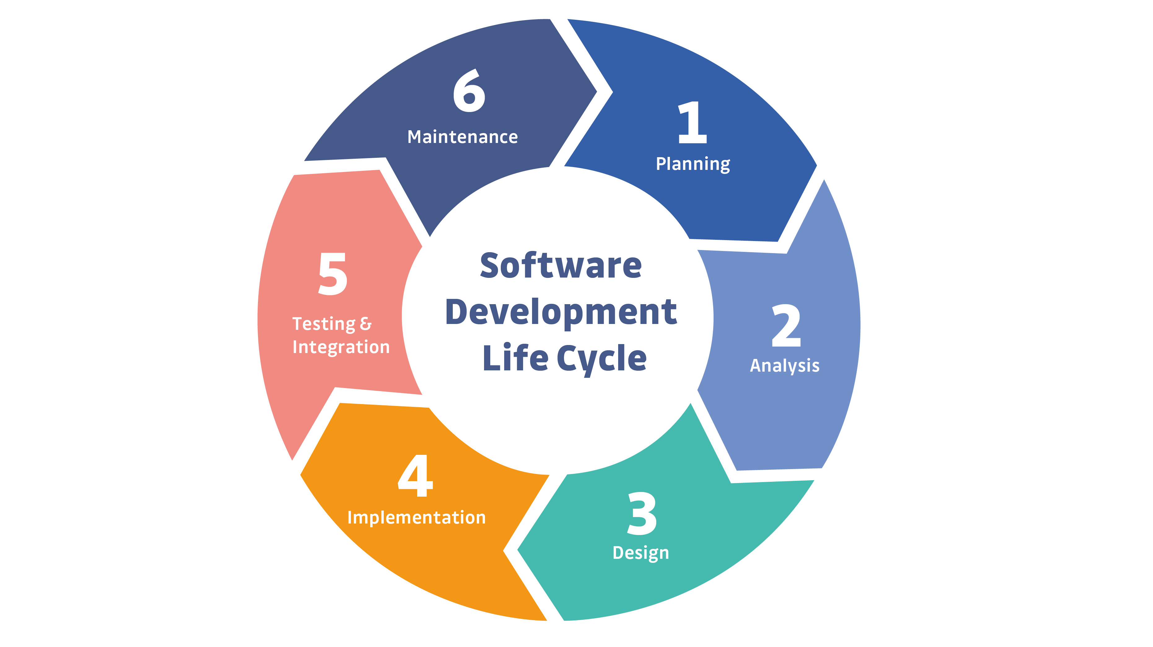
Notes:
This is a simple example of the SDLC. Typically, representations of the SDLC will have around 6 steps, but the steps will generally match what you see here.

Slide 61

More To Come on the SDLC Next Time!

Slide 62

Questions?

Slide 63

Review Day 2

Slide 64

Preview day 3

